Slide 1
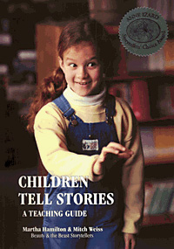
Children as Authors and Storytellers
Session 2b in Exploiting and Exploring Storytelling

Slide 2
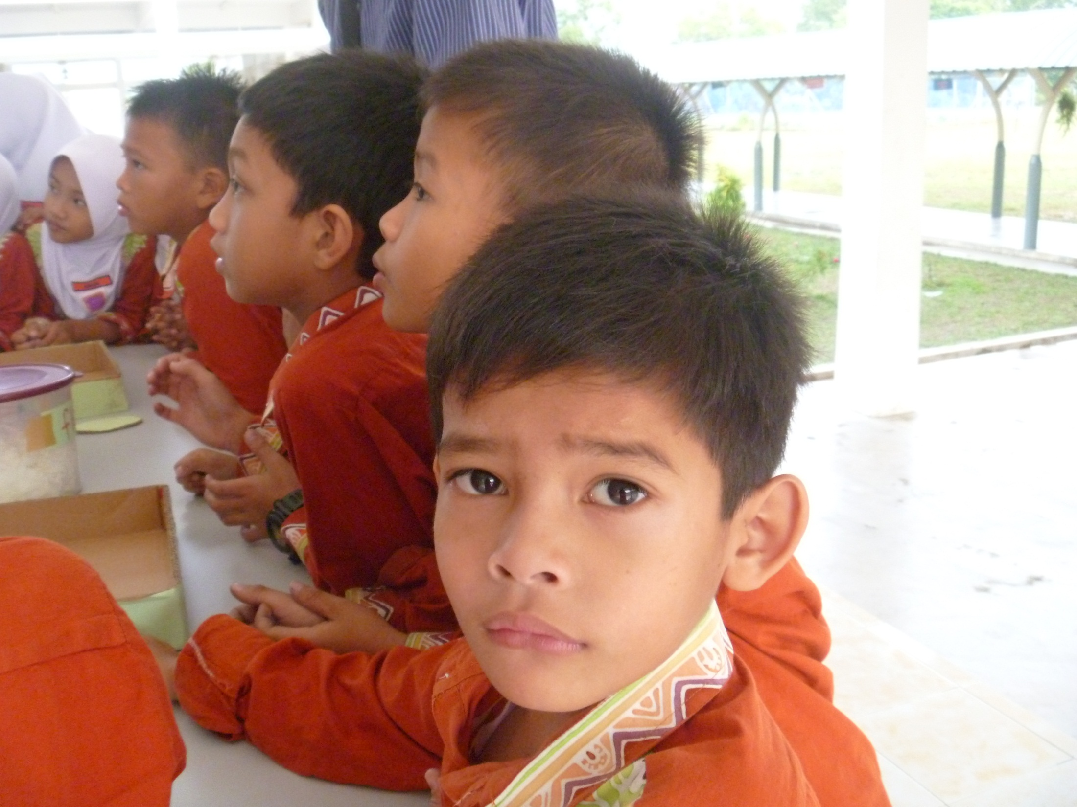
What do kids really want?

Slide 3
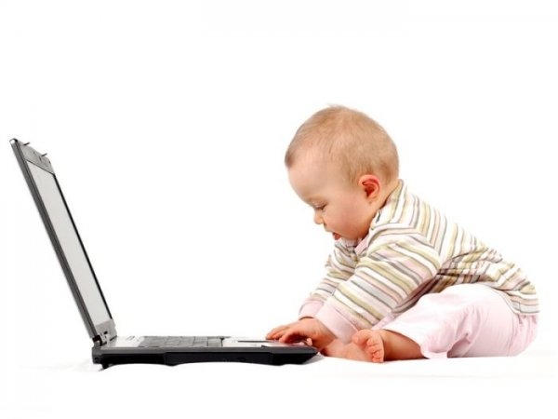
1. Children as authors

Slide 4
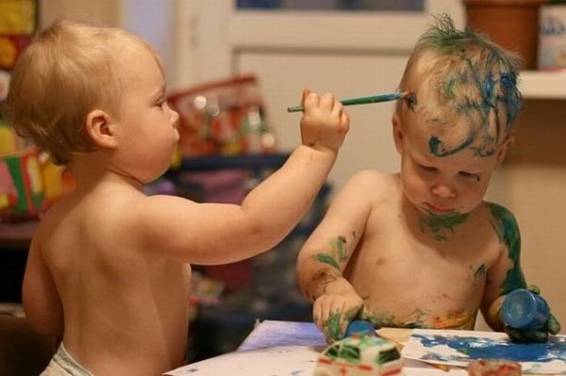
Artwork

Slide 5
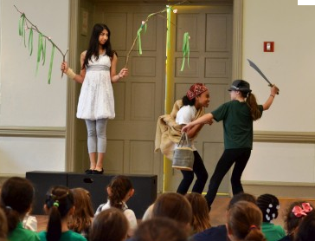
Dramatize

Slide 6
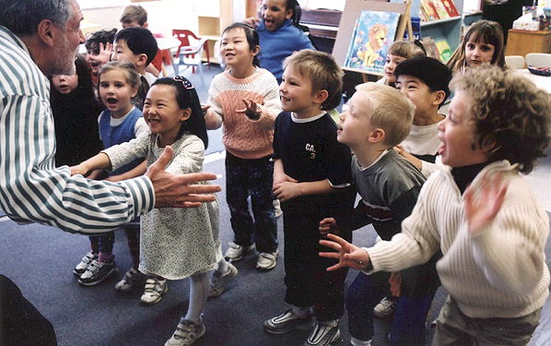
Join in with the story

Slide 7
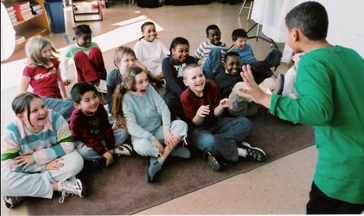
Children retell stories

Slide 8
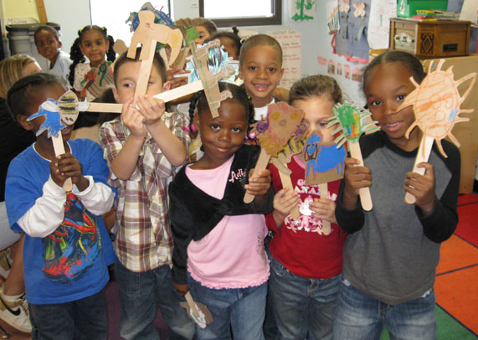
Puppets

Slide 9
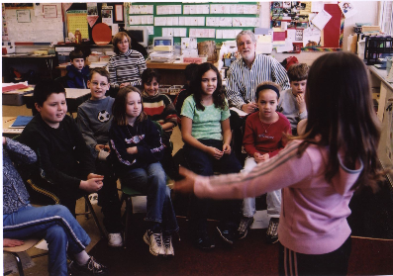
2. Children as Storytellers

Slide 10
Story Sequence
1
2
3
4
5
6

Slide 11
Index Cards for Story Plan

Slide 12
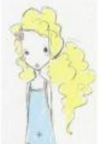
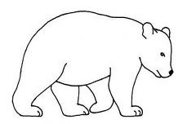
Character Map
Pretty, yellow hair
Likes to explore
Goldilocks
Gets hungry a lot
Scared of animals
Gets sleepy
Selfish, thoughtless
Bad manners

Slide 13
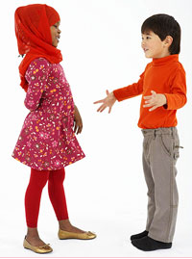
Paired Talks

Slide 14
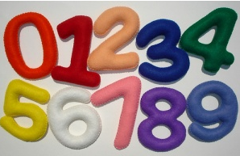
Count to ten …
Angry Parent
Learning to count
Counting your presents
Boxing referee
Bad phone connection
Counting coins

Slide 15
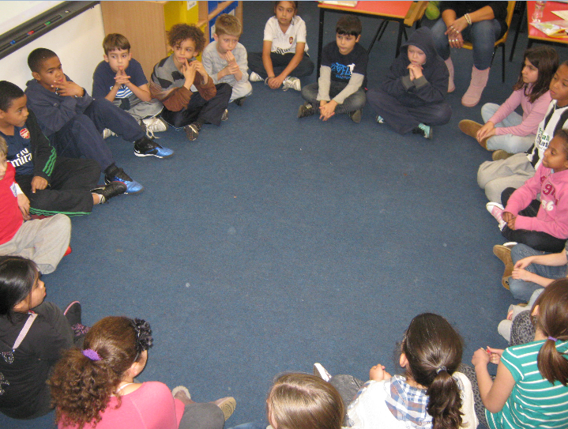
Circle Stories

Slide 16
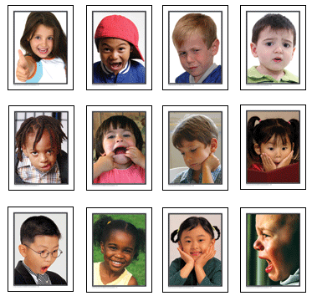
Pass the Face

Slide 17
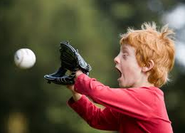
Catch It!

Slide 18
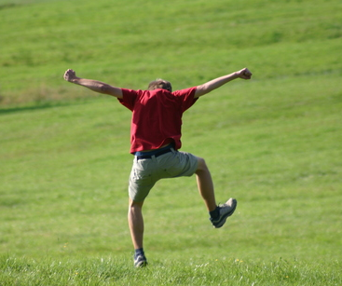
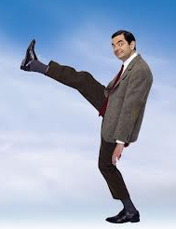
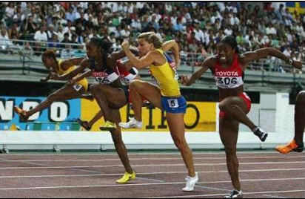
Walking

Slide 19
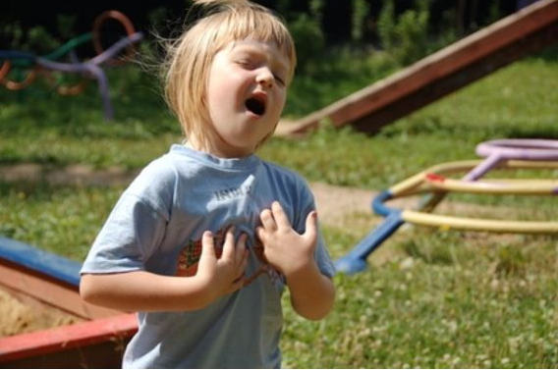
Voice Projection

Slide 20
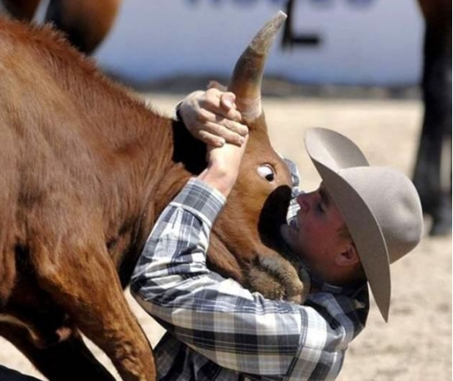
Eye Contact

Slide 21
Pauses
Actions
Faces
Props
Voices

Slide 22
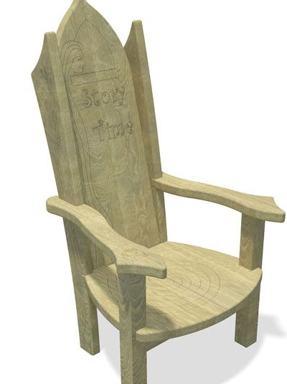
Story Chair

